Slide 1
Online Programs & Parental Involvement
Bridgeprep Academy interamerican
Mr. Antonio Cejas, principal

Slide 2
New World of Learning
It takes a village to raise a child.
Looks different in each family and classroom.
Teachers are dealing with different modalities and new issues arise everyday.
How can we make things better?
Stay connected with teacher and school.
Hold your child accountable for their work and their participation.
Follow school rules and procedures
Be present
Be understanding
Be patient
Be kind

Slide 3
Online Programs Help us build independent thinkers by allowing them to make their own mistakes and work on getting better!

Slide 4
I-Ready
Reading, Math and Spanish Intervention program.
i-Ready Login
Must download the I-ready Application to your computer or tablet.
I-Ready Support

Slide 5
Parental Involvement
Class Dojo
https://www.classdojo.com/about/
Student Grades
http://www.dadeschools.net/parents.asp
Bridgeprep Academy Website
BridgePrep Academy InterAmerican

Slide 6
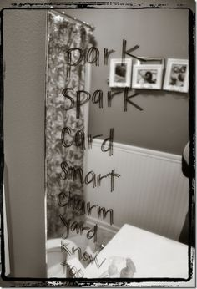
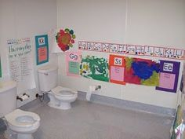
Reading Everywhere!

Slide 8
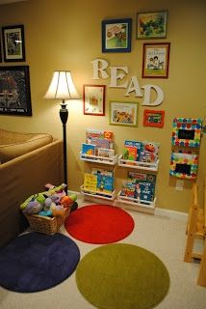
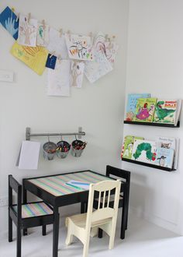
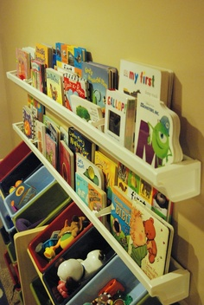
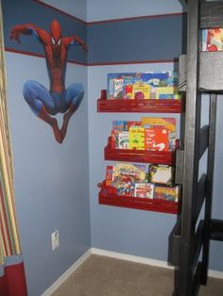

Slide 9
Remember These 10 Guiding Principles
Family members are equal partners in a child’s education.
The home environment is the “primary” educational environment.
Schools must respect the diversity of families and their varied needs.
All families care about their children.

Slide 10
Family involvement is important through all years of a child’s education.
Family involvement takes many forms and may not require a family’s presence at school.
Families, schools, and communities are closely interconnected and must collaborate in educating children.

Slide 11
Thank you for trusting us with your child. We are looking forward to a successful school year.

